Slide 1
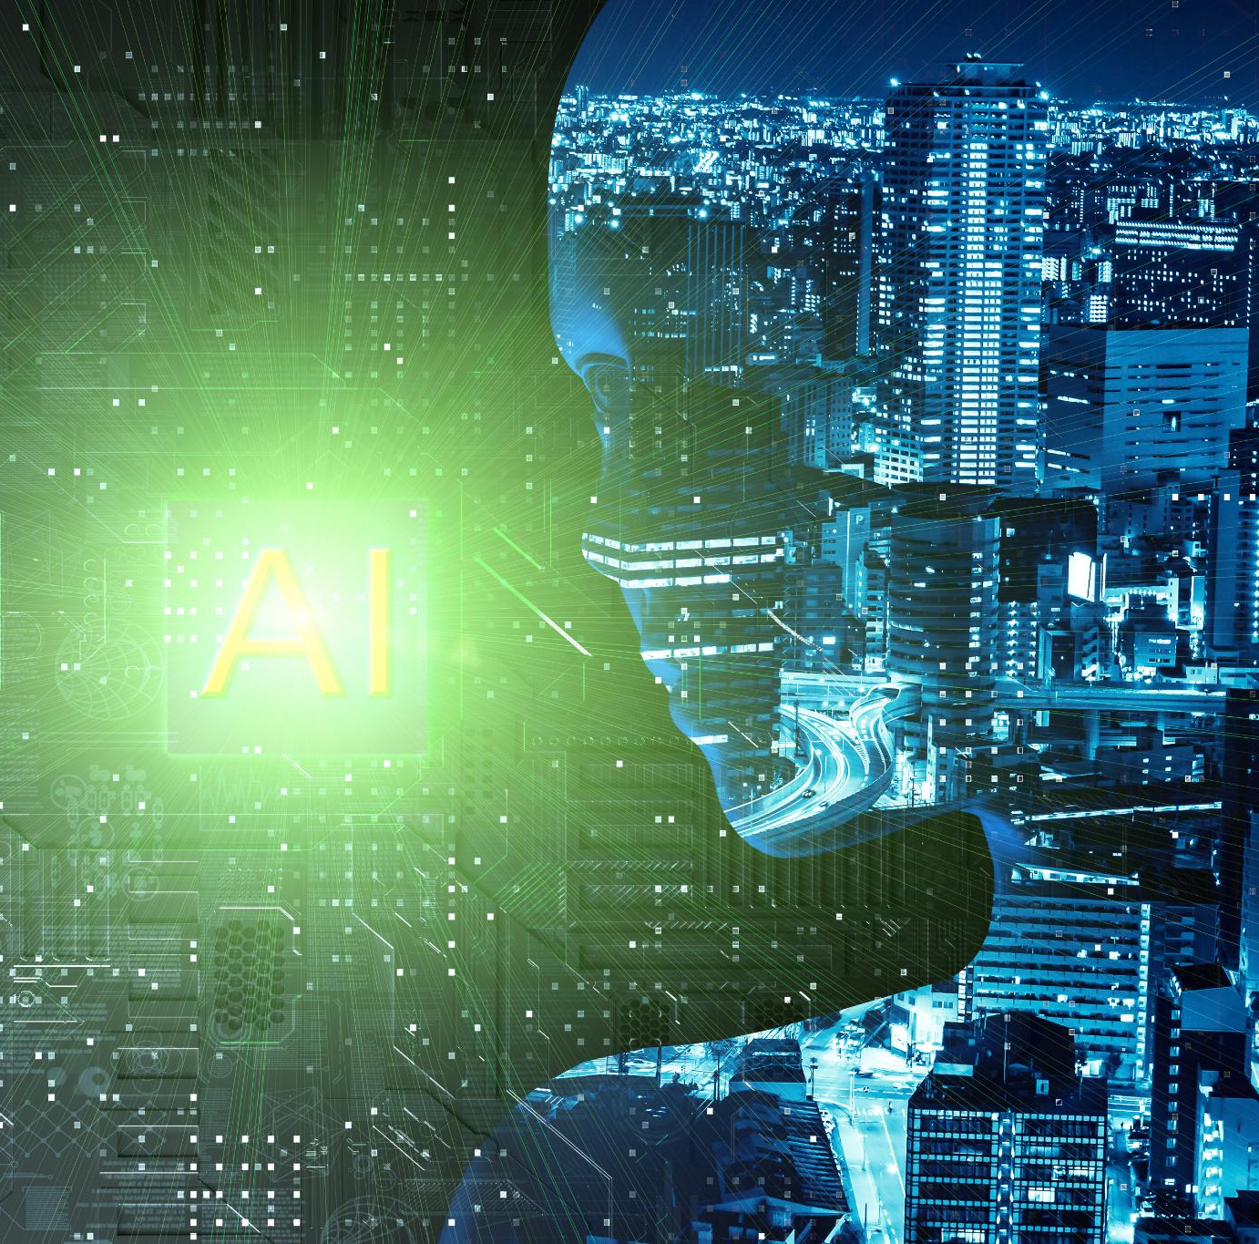
ITAI-1378 Great Achiever Team
Oluwatoyin Abolarin
Andre Ellis
Sharise Grigggs
Khanh Huynh
Enrique Quintero Garcia

Slide 2
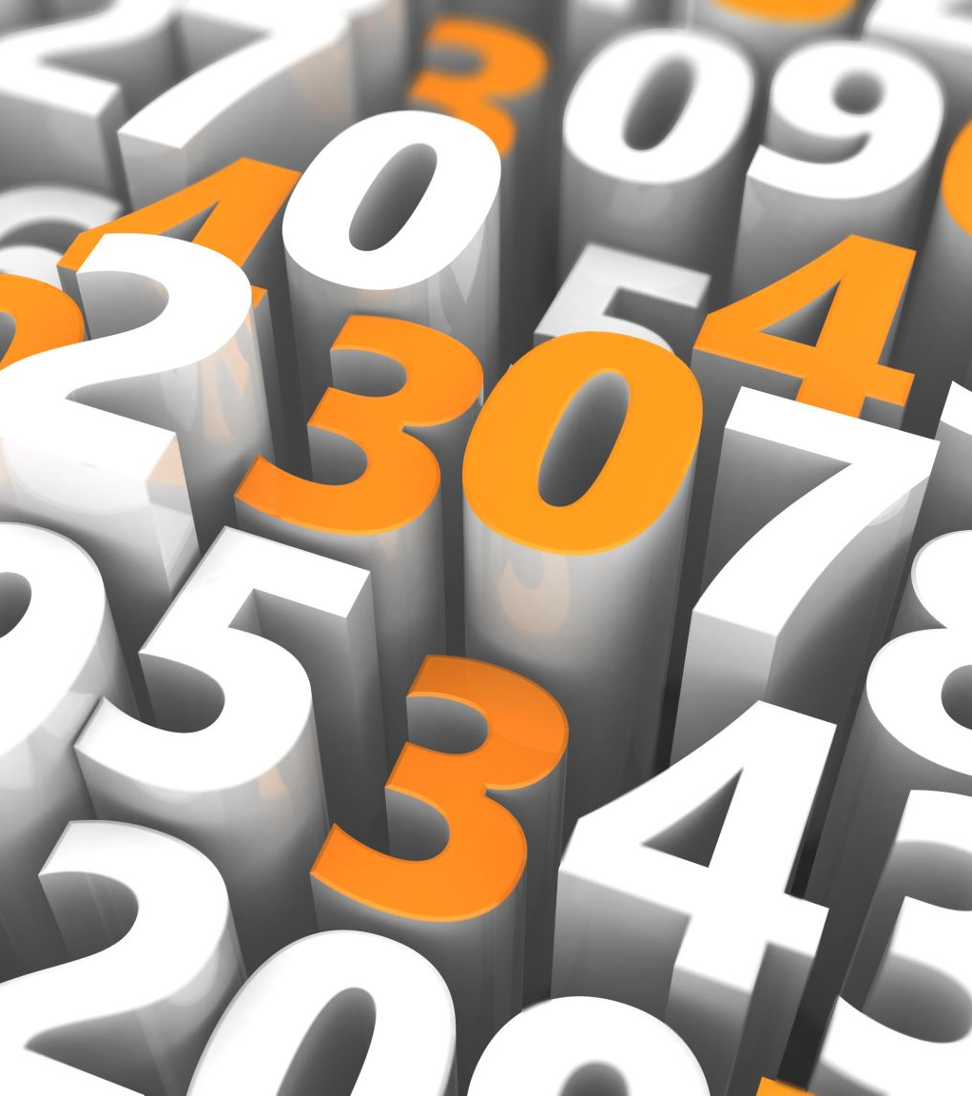
Table of Content
Introduction to Computer Vision
Table of Content
Advancements in Computer Vision During the 2010s
Key advancements
Influential figures
Impactful applications
Advancements in Computer Vision During the 2020s
Key advancements
Influential figures
Impactful applications
Visual Timeline of Computer Vision Advancements in the 2010s
Visual Timeline of Computer Vision Advancements in the 2020s
References

Slide 3
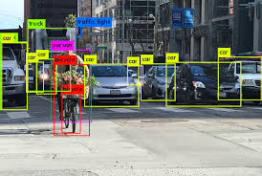
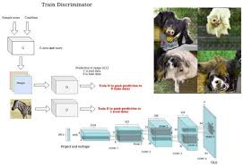
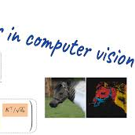
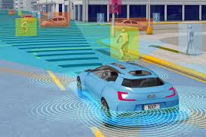
Introduction to Computer Vision , a Subfield of AI in 2010s and 2020s
Definition and Scope: Computer vision, a subfield of AI, enables machines to interpret and process visual information from the world.
Historical Context: Significant advancements occurred in the 2010s and 2020s, driven by deep learning techniques and the development of foundational projects.
Key Technologies: Utilizes neural networks, convolutional neural networks (CNNs), and large datasets; recent innovations include transformers and generative intelligence.
Current Applications: Found in autonomous vehicles, facial recognition, healthcare diagnostics, and evolving camera and sensor technologies, reflecting its broad impact.

Slide 4
Key Advancements in 2010
ILSVRC | ImageNet Large Scale Vision Recognition Change
AlexNET | CNN (Convolution Networks Neural) + ILSVRC
GAN | Generative Adversial Networks
RESNET | Residual Networks
Transformer in Vision
CLIP | Constractive Language Image Pretraining
Yolo | You Only Look Once
OpenCV | Open Compute Vision
Autonomous Cars | TESLA, DriveTaxi

Slide 5
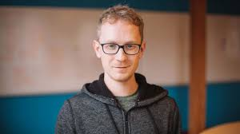
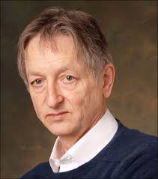
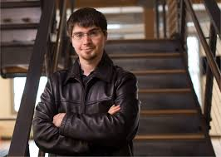
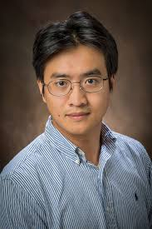
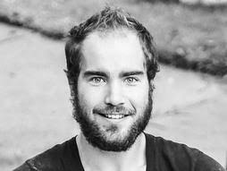
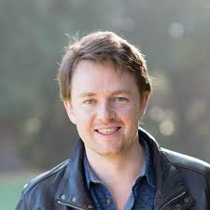

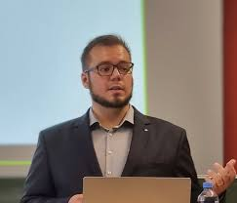
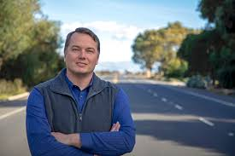
People who influenced Computer Vision in 2010
Name of influencer | Contribution
Geoffrey Hinton / Alex Krizhevsky | Deep Learning
Yann LeCun | CNN Development
Andrew Ng | Machine Learning
Fei-Fei Li | ImageNet Dataset
Demis Hassabis | Reinforcement Learning
Ian Goodfellow | Generative Adversarial
Joseph Redmon / Wei Liu | YOLO Detection

Slide 6
People who influenced Computer Vision in 2010 (contd.)
Yaniv Taigman / Florian Schroff | FaceNet Recognition
Chris Urmson / Andre Bieclen | Autonomous Vehicles

Slide 7
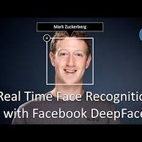
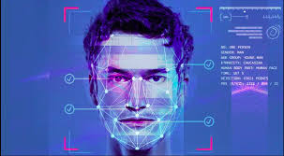
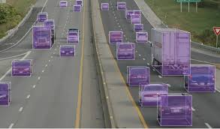
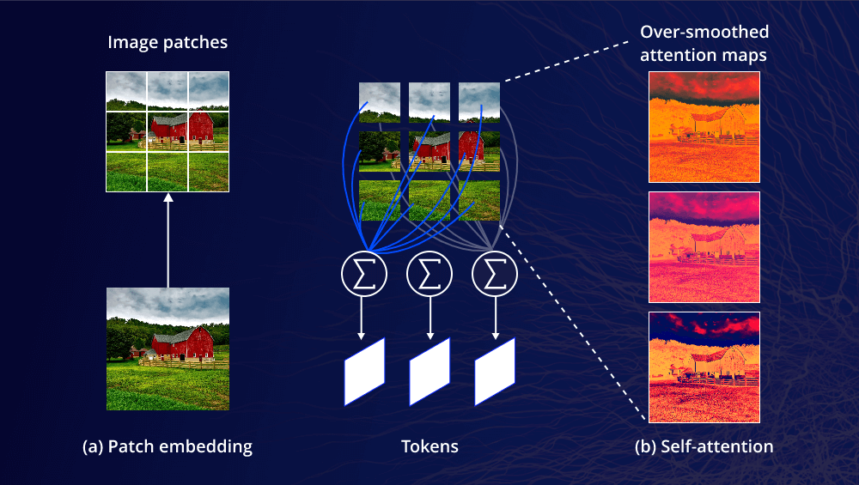
Impactful Applications of Computer Vision in 2010
Computer vision is at the core of autonomous vehicle technology. By leveraging object detection algorithms while also using the latest sensors and cameras, autonomous vehicles get to recognize their surroundings, making the entire driving process safer and easier.
Deep Face AI is the most lightweight face recognition and facial attribute analysis library for Python. The open-sourced Deep Face library includes all leading-edge AI models for modern face recognition and automatically handles all procedures for facial recognition in the background. (Face Verification , Face Recognition )
Facial Attribute Analysis: The task of facial attribute analysis refers to describing the visual properties of face images. Accordingly, facial attributes analysis is used to extract attributes such as age, gender classification, emotion analysis, or race/ethnicity prediction.
Real-Time Face Analysis: This feature includes testing face recognition and facial attribute analysis with the real-time video feed of your webcam.

Slide 8
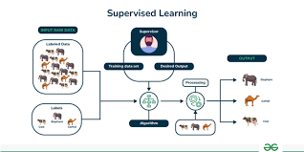
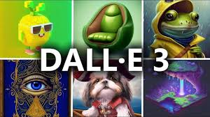
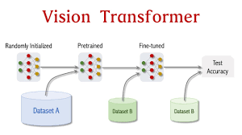
Key Advancements in 2020
Vision Transformers (ViT): Transformers adapted from NLP to vision tasks, outperformed traditional CNNs on some benchmarks by effectively handling image classification.
Self-Supervised Learning (SSL): Techniques like SimCLR and BYOL enabled models to learn useful image representations from unlabeled data, reducing the reliance on large labeled datasets.
Neural Radiance Fields (NeRF): Advanced 3D scene representation and rendering technology, providing highly realistic 3D visualizations from 2D Images.
EfficientNet: A model that balances accuracy and efficiency by optimizing network width and depth, introduced in 2019 but continued to influence advancements in 2020.
DALL-E and CLIP: OpenAI’s DALL-E generated detailed images from text descriptions, while CLIP improved multi-modal learning by enabling machines to understand and relate images and text, enhancing search and captioning capabilities.

Slide 9
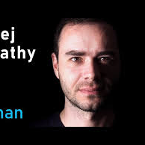
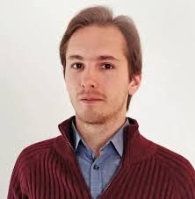
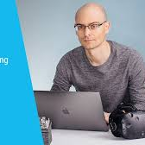
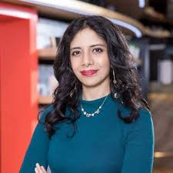
People who influenced Computer Vision in 2020
Alexey Dosovitskiy: Key developer of Vision Transformers (ViT), which shifted the paradigm from CNNs to transformer models for vision tasks.
Andrej Karpathy: Played a critical role in advancing Tesla's autonomous driving vision systems.
Anima Anandkumar: Contributed significantly to AI in vision systems and autonomous driving.
Pieter Abbeel: Leader in deep reinforcement learning and robotics, contributing to advancements in vision for autonomous systems.
Yann LeCun: Continued to advance the field with contributions to self-supervised learning and other deep learning techniques.

Slide 10
People who influenced Computer Vision in 2020 (contd).
Abhinav Gupta: Worked on advancements in robotic perception and object detection, influencing practical applications of computer vision.
Ari Morcos: Contributed to self-supervised learning techniques, such as SimCLR, which improved image representation from unlabeled data.
Jitendra Malik: Made significant contributions to computer vision research and the development of neural representation techniques, including Neural Radiance Fields (NeRF).

Slide 11
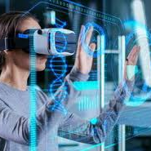
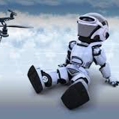
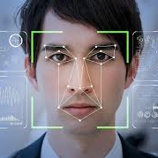
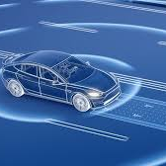
Impactful Applications of Computer Vision in 2020
Autonomous Vehicles: Modern advancements like Vision Transformers and SSL methods are used to enhance visual understanding in self-driving cars, making them more reliable and safer.
Healthcare Diagnostics: AI-based imaging continues to grow, especially with self-supervised learning improving performance without relying on large labeled datasets.
3D Vision for AR/VR: NeRF is now widely used to create highly immersive 3D environments, boosting virtual simulations, architecture, and gaming experiences.
Text-to-Image Systems: Tools like DALL-E have revolutionized content creation, offering a wide range of applications in design, marketing, and entertainment through automated visual generation from textual inputs.
Real-time Facial Recognition and Biometrics: Advanced vision models are enhancing surveillance, security, and authentication systems, making them more accurate and scalable.
Robotics and Drones: Deep learning and vision transformers are enabling real-time perception and decision-making in robots and drones, making them more effective in tasks like exploration, mapping, and deliveries.

Slide 12
Visual Timeline of Computer Vision Advancements in the 2010s
2010
ImageNet
2014
GAN
2016
Yolo
Autonomous Car
Decade 2010s
2015
RestNET
TensorFlow
Keras
Tesla
2019
TransformerVision
2012
AlexNet
OpenCV.org

Slide 13
Visual Timeline of Computer Vision Advancements in the 2020s
2020
ViT
NeRF
2022
Public Stable Diffusion
Decade 2020s
2021
Dall-E

Slide 14
References
1. Alexey Dosovitskiy and Vision Transformers (ViT):
Dosovitskiy, Alexey, et al. "Attention Is All You Need." arXiv, 2017, https://arxiv.org/abs/1706.03762.
Accessed 28 Aug. 2024.
2. Andrej Karpathy and Tesla's Autonomous Driving:
Karpathy, Andrej. "The Case for End-to-End Learning for Self-Driving Cars." arXiv, 2016, https://arxiv.org/abs/1612.05560.
Accessed 28 Aug. 2024.
3. Anima Anandkumar and AI in Vision Systems:
Anandkumar, Anima, et al. "Tensor Methods for Machine Learning." Foundations and Trends in Machine Learning, vol. 8, no. 3-4, 2015, pp. 145-282. Accessed 28 Aug. 2024.
4. Pieter Abbeel and Vision for Autonomous Systems:
Abbeel, Pieter, and Trevor Darrell. "Learning to See and Act." Communications of the ACM, vol. 62, no. 6, 2019, pp. 48-57. Accessed 28 Aug. 2024.
5. Yann LeCun and Self-Supervised Learning:
LeCun, Yann, et al. "Self-Supervised Learning: The Dark Matter of Intelligence." arXiv, 2020, https://arxiv.org/abs/2006.18209.
Accessed 28 Aug. 2024.
6. Abhinav Gupta and Robotic Perception:
Gupta, Abhinav, et al. "Visual Semantic Role Labeling for Robotic Perception." arXiv, 2019, https://arxiv.org/abs/1907.07168. \Accessed 28 Aug. 2024.

Slide 15
References ( Contd.)
7. Ari Morcos and SimCLR:
Morcos, Ari. "Self-Supervised Learning: Representation Learning with Contrastive Learning." arXiv, 2020, https://arxiv.org/abs/2002.05709.
Accessed 28 Aug. 2024.
8. Jitendra Malik and Neural Radiance Fields (NeRF):
Mildenhall, Ben, et al. "NeRF: Representing Scenes as Neural Radiance Fields for View Synthesis." arXiv, 2020, https://arxiv.org/abs/2003.08934.
Accessed 28 Aug. 2024
https://en.wikipedia.org/wiki/OpenCV
10. https://es.wikipedia.org/wiki/Veh%C3%ADculo_aut%C3%B3nomo
11. https://www.superannotate.com/blog/computer-vision-in-autonomous-vehicles

Slide 16
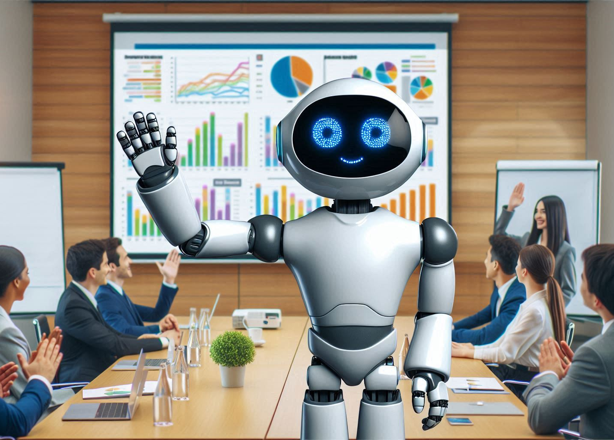
Thank you for reading

